Slide 1

COLLISION PIPELINE
IMAGINE
Olivier Carré - Moreno Trlin
22nd October 2013

Slide 2
SUMMARY
1. Collision models
2. Quick overview
3. The narrow phase
4. Collision group

Slide 3
Collision models
1

Slide 4

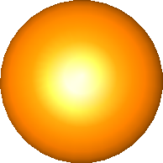
Collision models
What is a collision model ?
  Geometric representation of the object's surface, support of collisions.

Slide 5
Collision models
What is a collision model ?
  Geometric representation of the object's surface, support of collisions
DOFs of a mechanical object
Linked to a mechanical object

Slide 6
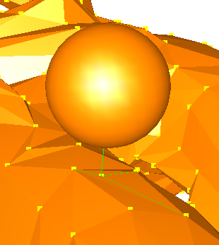
Collision models
Example of a collision
Impacted DOFs
contact point

Slide 7
Collision models
What is a collision model ?
  Geometric representation of the object's surface, support of collisions
  Linked to a mechanical object
  Contains internal informations, like sphere radii
r1
r2
r3
r4
r5
r6

Slide 8
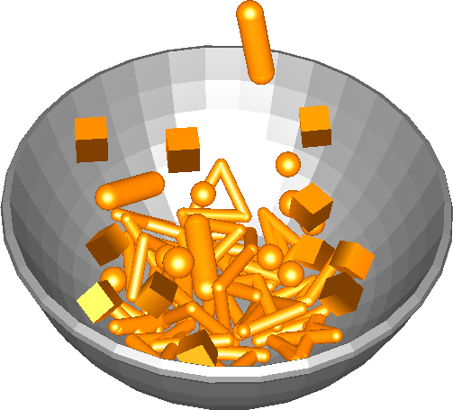
Collision models
Implemented collision models :
  SphereModel
  RigidSphereModel
  TriangleModel
  LineModel
  PointModel
  CapsuleModel
  OBBModel (oriented bounding box)

Slide 9
Quick overview
2

Slide 10
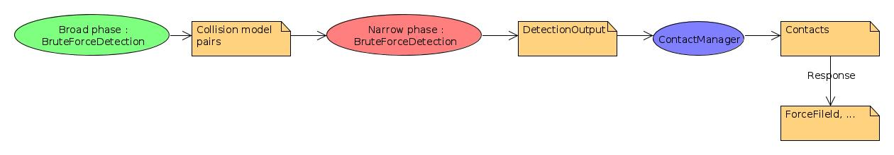
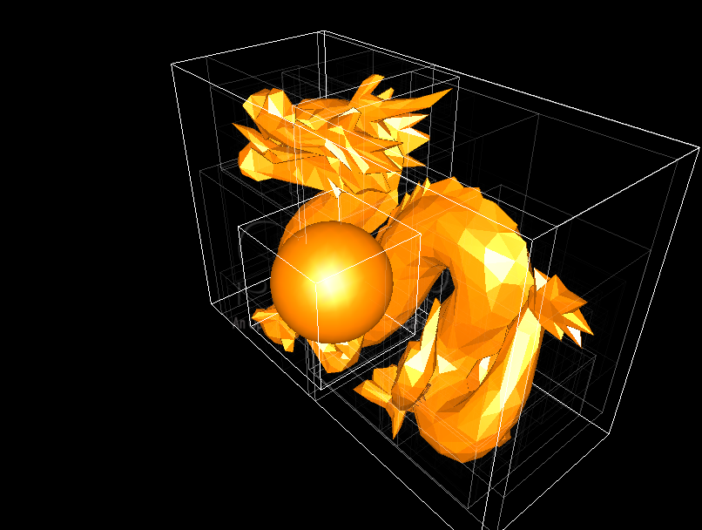
Quick overview
  Broad phase : intersection of collision model AABBs
  Narrow phase : descending in the AABB hierarchy and computation of intersection (if it exists), i.e. intersection points and other parameters
  BruteForceDetection implements both the narrow and the broad phase
  Broad phase implementations : BruteForceDetection, IncrSAP (SweepAndPrune)
  Response implementations : FrictionContact, BarycentricPenalityContact...

Slide 11
The narrow phase
3

Slide 12
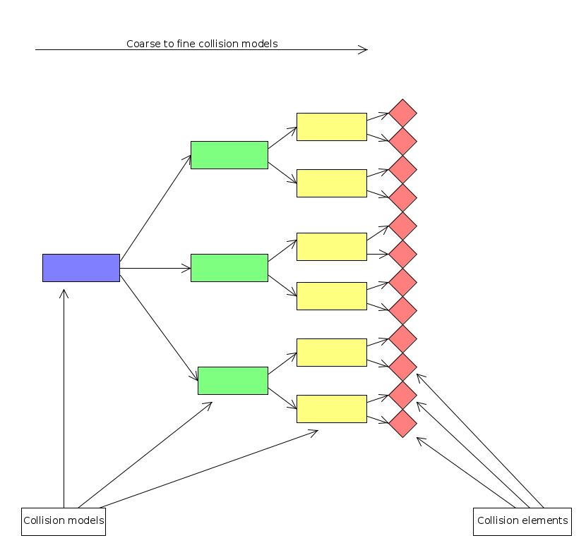
The narrow phase
Descending the AABB hierarchy
The coarse collision models are AABBs.
The collision elements are Spheres, Triangles...

Slide 13
The narrow phase
e1 : sphere
e2 : triangle
Intersection between e1 and e2, but we don't know their types and the method to use.
Narrow phase

Slide 14
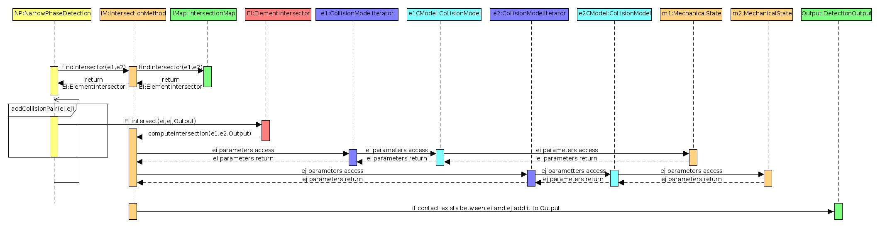
The narrow phase
BruteForceDetection
IntersectionMethod : set of intersection functions, it is present in the scene
IntersectionMap : given two collision elements, returns the right method tu use
DetectionOutput : result of the collision
IntersectionMethod implementations : DiscreteIntersection, MinProximityIntersection, NewProximityIntersection

Slide 15
The narrow phase
Intersection methods
alarmDistance : maximum distance between collision elements for wich a contact is created
contactDistance : parameter used in the contact creation
DiscreteIntersection : contact created when collision elements are intersecting, not fitted to surfacic collision models
MinProximityIntersection : contact created when collision elements are close to each other, optimized for meshes
NewProximityIntersection : contact created when collision elements are close to each other, not optimized for meshes
Collision models parameters
proximity : enlargement of the collision model, i.e., value added to the alarmDistance and the contactDistance and also when building AABBs in the broad phase

Slide 16
The narrow phase
Contact response
PenalityContact : default repsponse used, efficient but can have stability problems
LMConstraint : slower but much better stablility
You can specify which one you want to use in the DefaultContactManager

Slide 17
Collision group
4

Slide 18
Collision group
CollisionGroupManager : given a set of contacts, create integration groups
Contacts between models define a graph
« Simply » gathers connected subgraphs
Decide which integrator/solver will be used

Slide 19
Thank you

